Slide 1
Objectives
In this session, you will learn to:
  Develop XML maps
  Import and export XML data
  Use Visual Basic for Applications (VBA) in conjunction with Excel and automate repetitive tasks using macros
  Create forms using Visual Basic Editor (VBE) and customize the Excel workbook
Notes:
Share the objectives with the students.

Slide 2
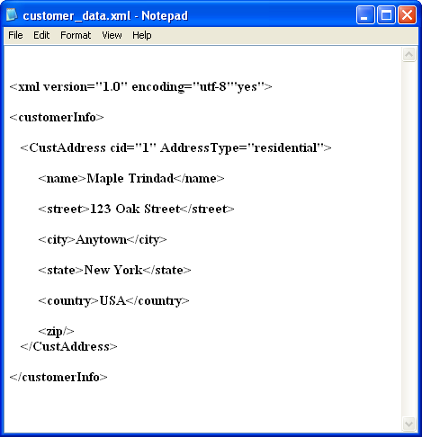
Develop XML Maps
Extensible Markup Language (XML) describes data by creating structured text files.
XML elements contain tags and the data within the tags, as shown in the following figure.
Saved with the .xml
file extension
XML Declaration
Readable and
easy to interpret
Content Within Tags
Tags

Slide 3
Develop XML Maps (Contd.)
XML components:
  The following figure shows various XML components.
Attribute of the
CustAddress element
The Root Element
Content
Opening Tag
Empty Element
Closing Tag

Slide 4
Develop XML Maps (Contd.)
An XML schema:
  Is an XML file that sets rules for XML files.
  Define the data type for the elements and attributes in XML files.
  Is saved with the .xsd file extension.

Slide 5
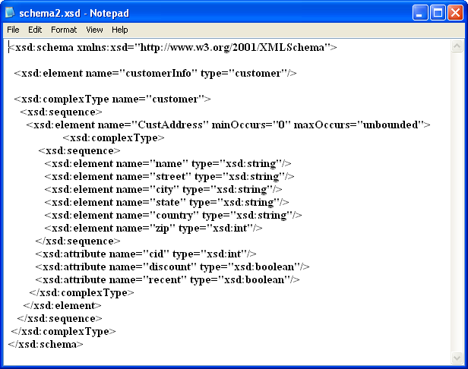
Develop XML Maps (Contd.)
The following figure shows an XML schema.
Saved with the .xsd
file extension
Definition for the
“customerInfo”
root element
Element Name
Definition for the
“CustAddress” element,
which is nested under
the “CustomerInfo”
root element
Definitions for
elements nested
under the
“CustAddress”
element
Data Type

Slide 6
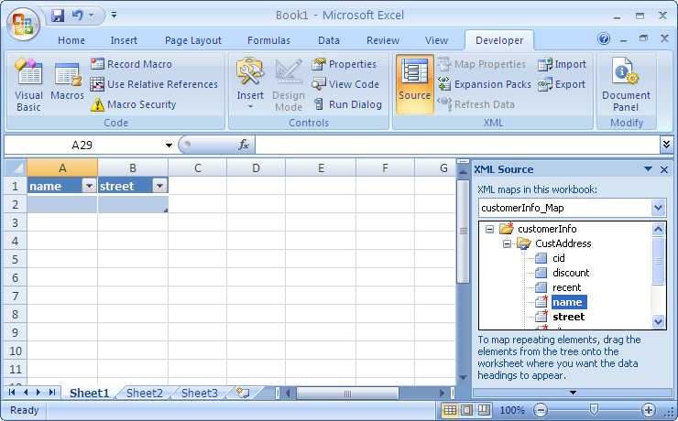
Develop XML Maps (Contd.)
An XML map is an Excel component that maps the contents of an Excel workbook to the corresponding elements of a specified XML schema.
The following figure shows an XML map based on an XML schema.
An XML map based
upon the customerInfo.xsd
XML schema
XML elements mapped
to specific cells
XML elements defined
in the schema

Slide 7
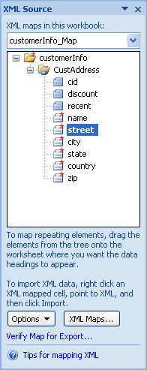
Develop XML Maps (Contd.)
The XML Source task pane contains various options, as shown in the following figure that are used to manage XML maps.

Slide 8
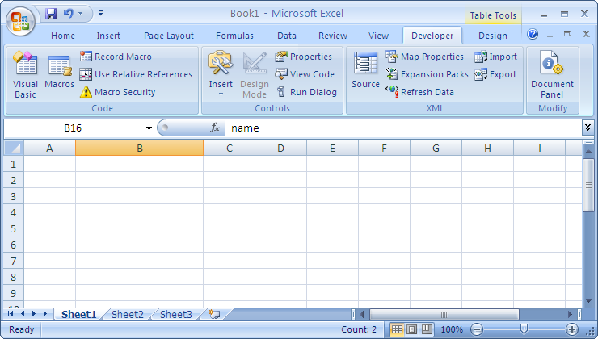
Develop XML Maps (Contd.)
The XML group on the Developer tab has various commands, as shown in the following figure that will allow you to work with XML files in Excel.
The commands in
the XML group

Slide 9
Demo: Developing XML Maps
Scenario:
  Your manager has sent you two XML schemas, Schema1 and Schema2. According to your manager, one of these files handles customer contact information; however, he doesn’t know how to tell which file is which. Once you figure out which schema handles customer contact information, the other map can be deleted. You decide to view both schemas in Excel and then delete the map you are not going to use. You will then map the contents of the correct schema to an Excel sheet and name the workbook My New Customer Data.

Slide 10
Demo: Developing XML Maps (Contd.)
Solution:
  To solve the preceding scenario, you need to perform the following tasks:
    If necessary, display the Developer tab on the Ribbon.
    Add Schema1.xsd and Schema2.xsd to a new, blank workbook.
    Map customer contact information from the XML Source task pane to the worksheet.
    Modify the map you just created.
    Delete the map that does not track
    customer contact information.
Notes:
Discuss the scenario of Activity 8-1 of Lesson 8 in the Student Guide with the students.
You can access the data files for this activity from the following path in the TIRM CD:
TIRM\DATAFILES FOR FACULTY\LEVEL 3\Session_03\Structuring Workbooks with XML\Schema1.xsd
TIRM\DATAFILES FOR FACULTY\LEVEL 3\Session_03\Structuring Workbooks with XML\Schema1.xsd

Slide 11
Import and Export XML Data
To manipulate data stored in XML files using the Excel interface, you need to import and export XML data in Excel.
The data in an XML-based workbook can be edited, deleted, cut, pasted, and sorted just like any other data in an Excel sheet.

Slide 12
Demo: Importing and Exporting XML Data
Scenario:
  Your manager has sent you an XML file, Customer Data, that contains customer contact data. You decide to import the XML data into the My New Customer Data workbook, which uses the Schema2 schema. Finally, he needs to create an XML version of the file because he needs to send it to another department that doesn’t use Excel. This new XML file needs to be named My Customer Data Update.

Slide 13
Demo: Importing and Exporting XML Data (Contd.)
Solution:
  To solve the preceding scenario, you need to perform the following tasks:
    Re-create the map in the My New Customer Data workbook so that the XML elements are contiguous.
    Import data for the specified field from the Customer Data XML file into the My New Customer Data workbook.
    Export the data to a new XML file.
Notes:
Discuss the scenario of Activity 8-2 of Lesson 8 in the Student Guide with the students.
You can access the data file for this activity from the following path in the TIRM CD:
TIRM\DATAFILES FOR FACULTY\LEVEL 3\Session_03\Structuring Workbooks with XML\Customer Data.xml

Slide 14

Recording Macros
A macro is a set of commands required to automate a task.
Whenever you need to perform the same task, you run the recorded macro
There are three possible locations to save a macro:
  This Workbook
  New Workbook
  Personal Macro Workbook

Slide 15
Customizing Macros
Existing macros may be modified and customized to suit your requirements.
Microsoft Excel converts the recorded steps into VBA code.
The IDE provides a centralized location for designing the user interface for the application, writing code, and compiling and debugging the application.
In addition to the standard interface elements, the VBE IDE contains other elements such as the Properties window, Code window, and Project Explorer window.

Slide 16
Demo: Creating Macros
Scenario:
  John Barrett of Books Treasure, Inc. needs to present the sales report for the month using the standard format. He has to work on a large number of worksheets to create the consolidated report. Here are the specifications to format the sales report:
    The current date should always appear at the top left corner of the worksheet.
    The column headings should appear in bold and blue in color.
    The name of the organization should be center aligned, red in color, bold, and underlined. Also, the font size should be 20 points.
    The data in the cells should be green in color and appear in italics. Also, the font size should be 10 points.

Slide 17
Demo: Creating Macros (Contd.)
Solution:
  To solve the preceding scenario, you need to create a macro to automate the task of formatting the report.
Notes:
Discuss the scenario of Activity 9-1 of Lesson 9 in the Student Guide with the students.
You can access the data file for this activity from the following path in the TIRM CD:
TIRM\DATAFILES FOR FACULTY\Excel Level 3\ Automating Business Operations\ Book Sales Report. xlsm

Slide 18
Demo: Customizing Macros
Scenario:
  Tom Wilkins of Books Treasure Inc., has suggested some changes in the specifications to format the sales report. Here are the new specifications:
    The column headings should appear in bold and red in color.
    The data in the cells should be green in color and appear in italics. Also, the font size should be 12 points.

Slide 19
Demo: Customizing Macros (Contd.)
Solution:
  To solve the preceding scenario, you need to edit the macro and customize it to the new specifications.
Notes:
Discuss the scenario of Activity 9-2 of Lesson 9 in the Student Guide with the students.
You can access the data file for this activity from the following path in the TIRM CD:
TIRM\DATAFILES FOR FACULTY\Excel Level 3\Automating Business Operations\ Edit Sales Report.xlsm

Slide 20
Customizing Excel Worksheets
Excel provides controls such as buttons, lists, and text boxes that can be added to a worksheet.
The Excel interface is customized by adding controls to:
  Display or enter data
  Perform an action
  Make the form easier to read
Notes:
If the application is for experienced users, it is better to use worksheets as the primary data input mechanism.

Slide 21
User Forms
A UserForm is a dialog box or a window for applications created in Excel and adds a professional look to the applications.
Users interact with the controls on the form to obtain the desired result.
Notes:
It is better to use forms as the primary data input mechanism, in case the user is not familiar with Excel.

Slide 22
Demo: Customizing Excel Worksheets
Scenario:
  John Barrett wants to customize the worksheet so that he is able to see the total sales in rupees and dollars. He also wants to display the category-wise total sales.

Slide 23
Demo: Customizing Excel Worksheets (Contd.)
Solution:
  To solve the preceding scenario, John need to perform the following:
    Add two option buttons inside a frame control for rupees and dollars. (By default total sales should be displayed in dollars)
    Add a command button and attach it to a macro that calculates the category-wise sales.
Notes:
Discuss the scenario of Activity 9-3 of Lesson 9 in the Student Guide with the students.
You can access the data file for this activity from the following path in the TIRM CD:
TIRM\DATAFILES FOR FACULTY\Excel Level 3\Automating Business Operations\ Categorywise Sales Report.xlsm

Slide 24
Summary
In this session, you learned that:
  File publish is a method of publishing data that has been created in an application to a web page.
  A web query allows you to import data that changes frequently on the web.
  An XML schema define the data type for the elements and attributes in XML files.
  The XML group on the Developer tab has various commands that help to work with XML files in Excel.
  A macro is a program that contains the statements required to complete a repetitive task.
Notes:
Use the Summary slide to summarize the session.

Slide 25
Summary (Contd.)
  There are three possible locations to save a macro:
    This Workbook
    New Workbook
    Personal Macro Workbook
  Excel converts the steps carried out to save to a macro into the VBA code. An existing macro can be edited in the VBE.
Notes:
Use the Summary slide to summarize the session.

